Slide 1
CS 97 Discussion 1B
Week 1
TA Howard Xie

Slide 2
Announcements
Office Hours set at Tues 1-2pm, Thurs 2-3pm
Assignment 1 due at 11:55pm, Monday 10/12 PST

Slide 3
Quick Poll on Zoom
How are you doing?
1
2
3
4
5
How far are you on Assignment 1?

Slide 4
Today’s Agenda
Relative / Absolute Path
Soft / Hard Links
Linux Permissions
Shell Scripting
Lab Worksheet (download from CCLE)

Slide 5
Relative / Absolute Path
Relative path: the path is “relative” with respect to the current working directory (the output of pwd)
Absolute path: the path begins with the root directory (/)

Slide 6
Hard Link
ln <file> <link>
Only works on files, not directories
Creates a “copy” but the two files are linked
Why?
Linked by the same underlying inode
Demo

Slide 7
Soft Link
ln -s <file> <link>
Soft links work on directories
A pointer from one file to another (shortcut)
If we remove the target, the pointer will be dangling
Demo

Slide 8
Linux Permissions
rwx|rwx|rwx (owner|group|public)
Sometimes represented as binary numbers
777 → 111|111|111 → rwx|rwx|rwx
Actually has an additional character at the beginning
The first character could be d or -
d means directory
- means file
Demo

Slide 9
Shell Scripting
Commands you have been typing in your terminal can be written in a shell script
Ex: ls, pwd, echo, …
The top of the script file should specify which shell program to use
Eg. #!/bin/bash
How would you execute a shell script named myscript.sh in your current directory?
Give execution permissions to myscript.sh first! (chmod +x myscript.sh)
To execute myscript.sh: ./myscript.sh

Slide 10
Shell Scripting (cont.)
Can we pass arguments into a shell script?
Yes!
How do we pass arguments into a shell script?
./myscript.sh argument1 argument2 argumentN
How do we access the arguments in a shell script?
$1, $2, $3, … (first, second, third, so on… argument)
${n} for 10 and above

Slide 11
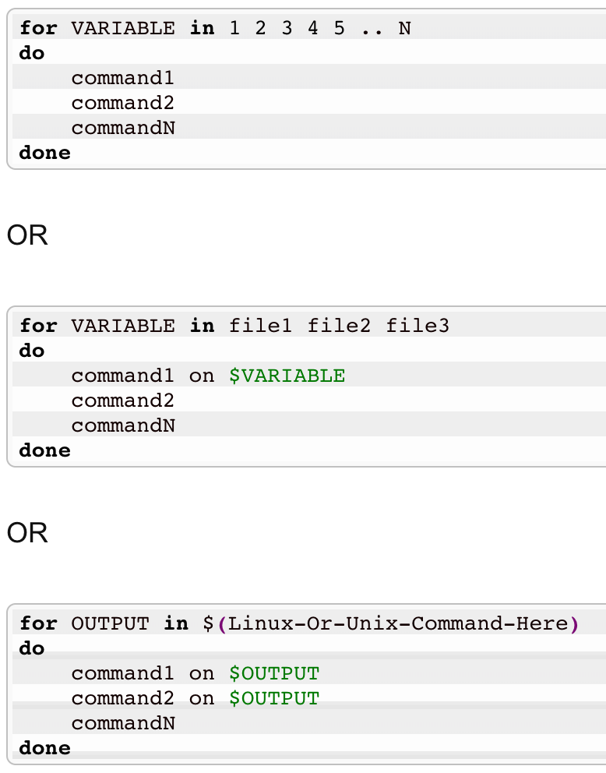
Shell Scripting (cont.)
How do we use a for loop in a shell script?
For loop syntax:

Slide 12
Worksheet Time - Break Out Rooms
Download the worksheet from CCLE and work on it with others in your break out rooms.

